Slide 1
Truss Optimization in 3D
ME 260 Structural Optimization : Size ,Shape and Topology
Instructor : Prof . G K AnathaSuresh
Presented by
Jayhind chauhan(22737)
Gunturu Akhil Sai Krishna Mouli(23166)

Slide 2
Problem Statement
Optimize 3D truss structures for minimizing mean compliance (maximizing stiffness).
Ensure the material volume is fixed and constraints are satisfied.
Determine the optimal material distribution across truss elements.
Motivation
Efficient material usage is essential for lightweight and high-performance structural designs.
Optimizing 3D trusses for stiffness benefits industries such as aerospace, civil, and mechanical engineering.
Contributes to sustainable and cost-effective design practices.

Slide 3
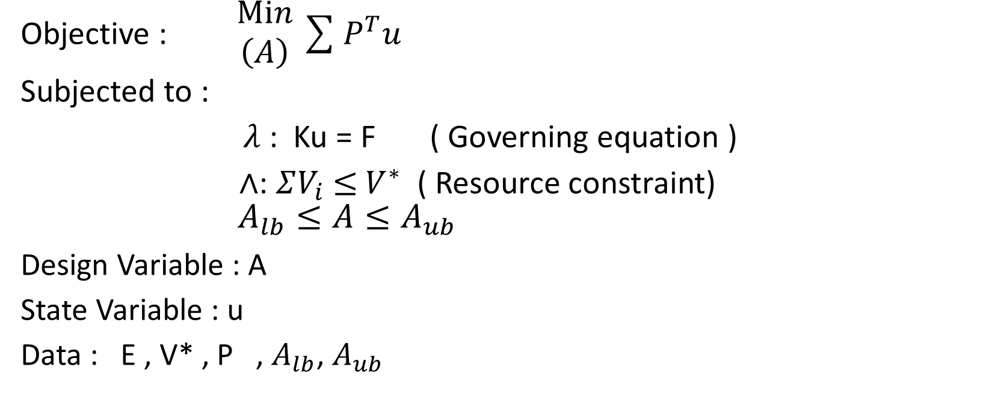
Mathematical description
Objective : $\begin{matrix}Min \\ \left(A\right)\end{matrix}\sum{P^{T}u}$
Subjected to :
$λ$ : Ku = F ( Governing equation )
$∧$: $ΣV_{i}$ $≤$ $V^{∗}$ ( Resource constraint)
$A_{lb}≤A≤A_{ub}$
Design Variable : A
State Variable : u
Data : E , V* , P , $A_{lb}$, $A_{ub}$

Slide 4

Algorithm
Initialization:
Set up the initial areas as the initial guess.
Define parameters such as maximum iterations , tolerance, and tuning parameter β.
Strain Energy Computation:
Perform a finite element analysis to compute strain energy for all truss elements
Calculate the strain energy density for each element based on the stiffness, volume, and material properties.
Area Update Using Optimality Criteria:
Compute the Lagrange multiplier (Λ) to satisfy the volume constraint.
Update the area of each truss element using the formula:
Ensure the updated areas satisfy the Area bounds

Slide 5
Algorithm (Contd.)
Iterative Adjustment:
If any areas violate the constraints, adjust the areas iteratively and recompute the Lagrange multiplier.
Repeat until all constraints are satisfied.
Convergence Check:
Check for convergence by comparing the maximum change in area values between consecutive iterations.
Terminate the iterations if the maximum change is below the defined tolerance
Finalization:
Filter out elements with very small areas.
Prepare the optimized structure for post-processing.

Slide 6
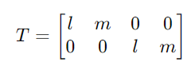
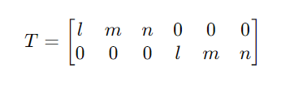
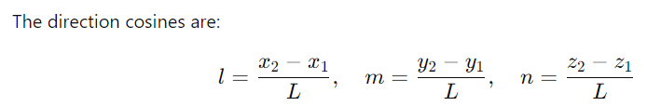

2D 3D
Transformation Matrix
Jcsj
Removing Overlapping Elements in ground structure

Slide 7
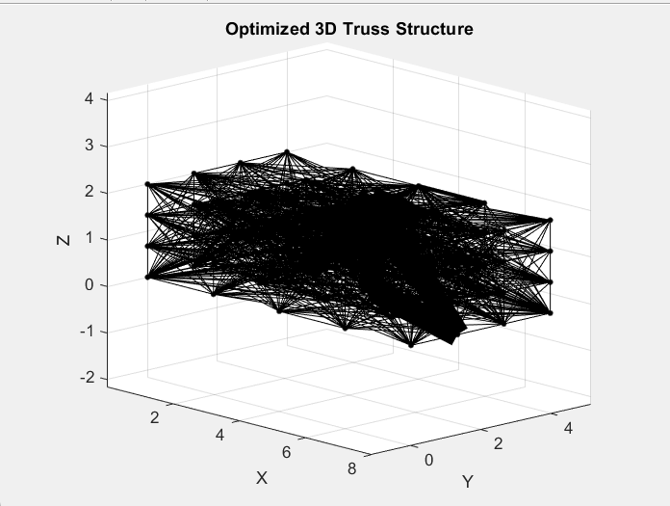
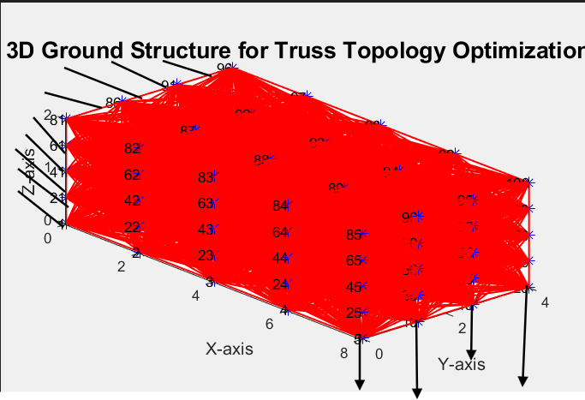
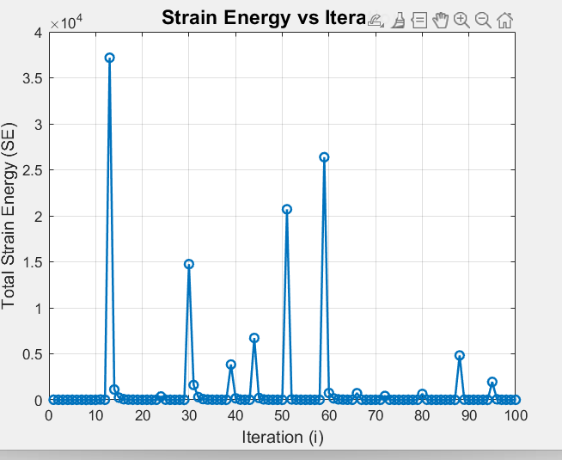

Example(1)
Truss Structure is non Optimal
Tune $β$

Slide 8
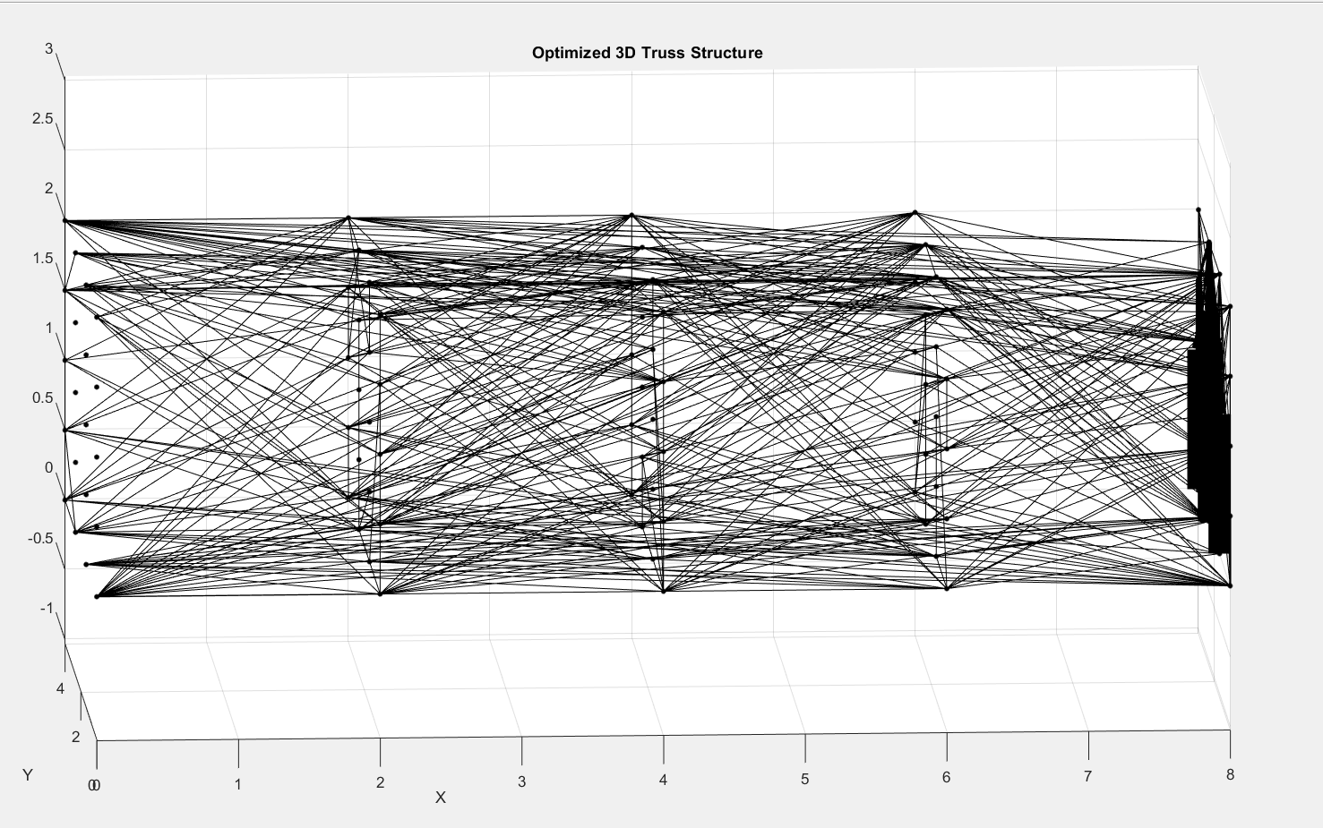
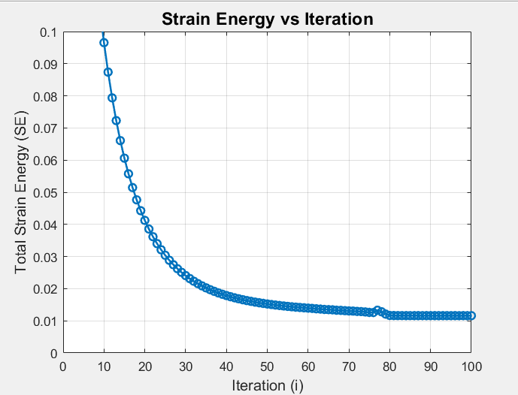
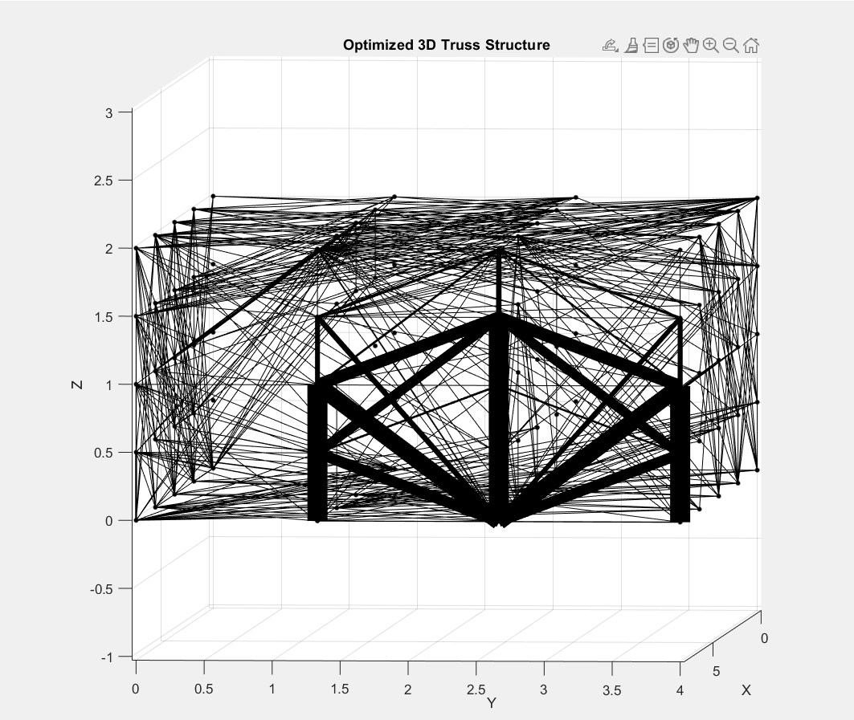
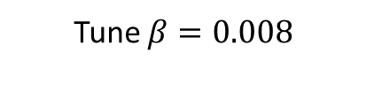
Example(1)
Tune $β=0.008$

Slide 9
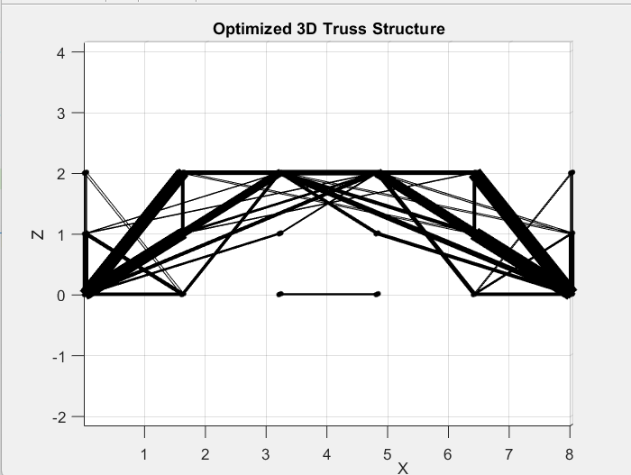
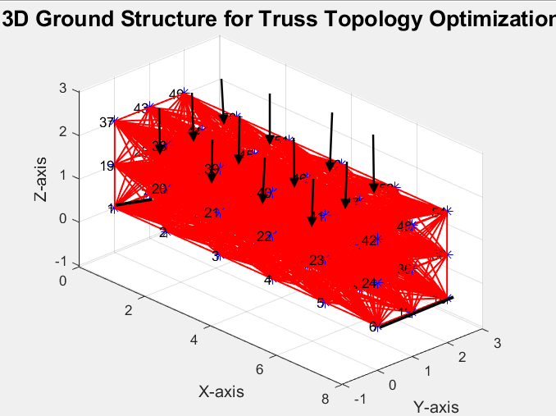
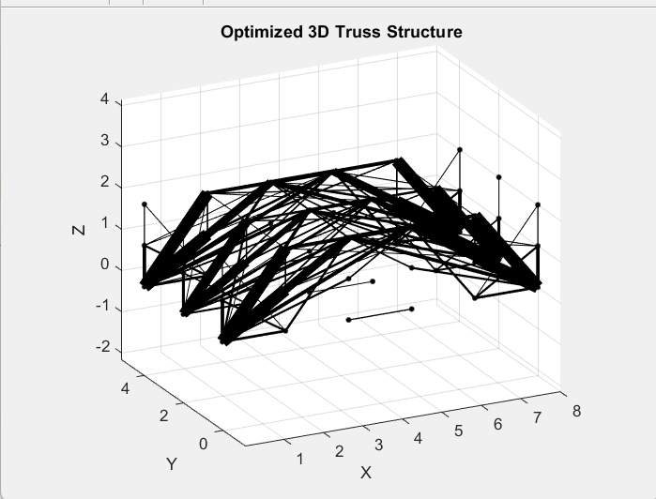
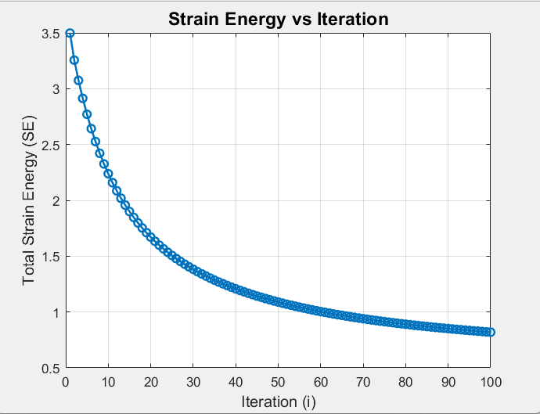
Example(2)

Slide 10
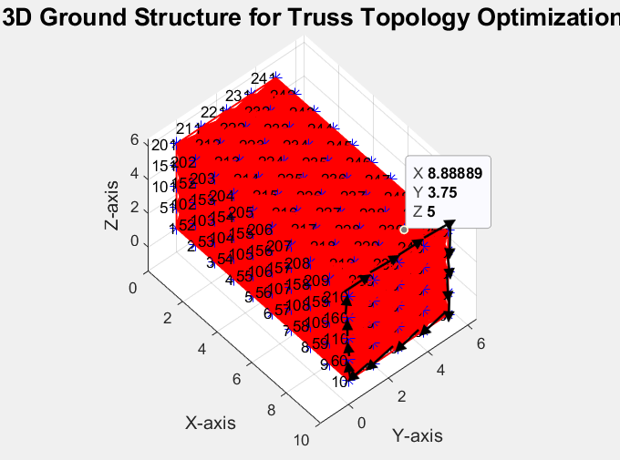
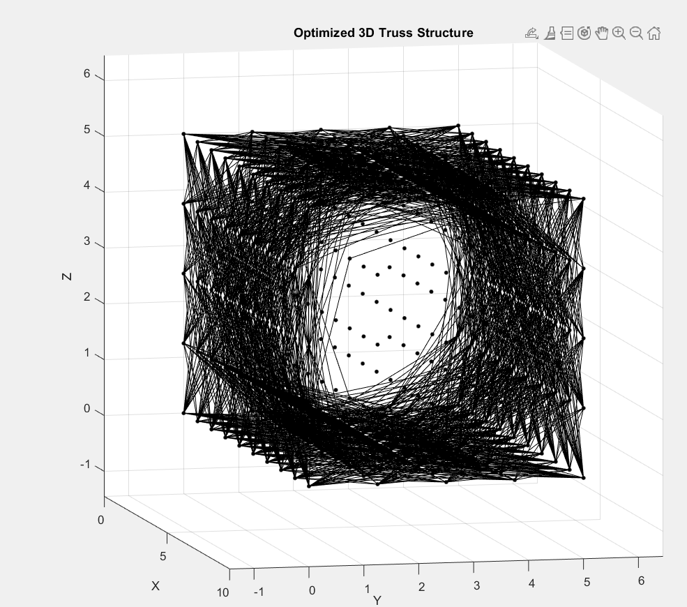
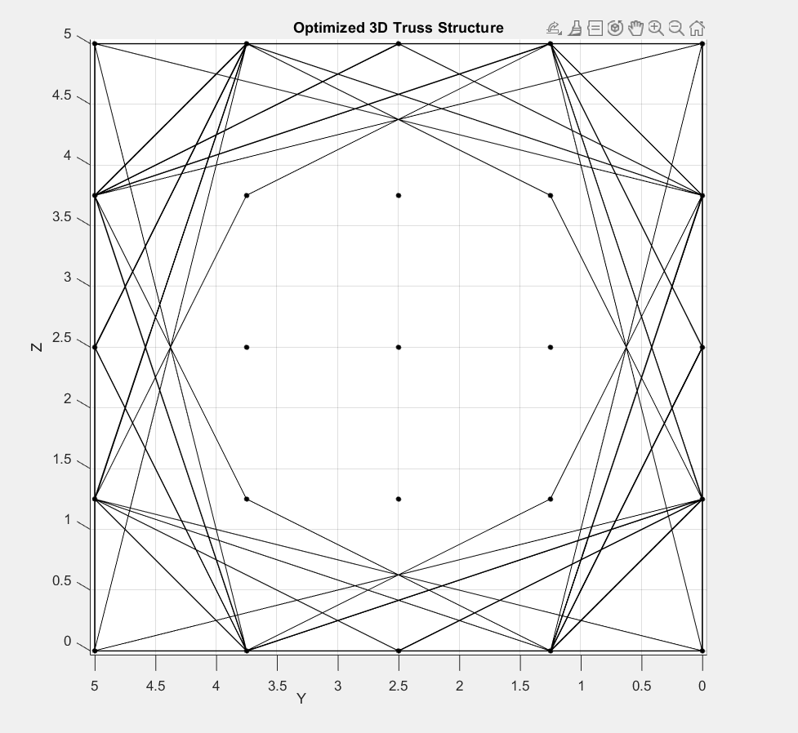
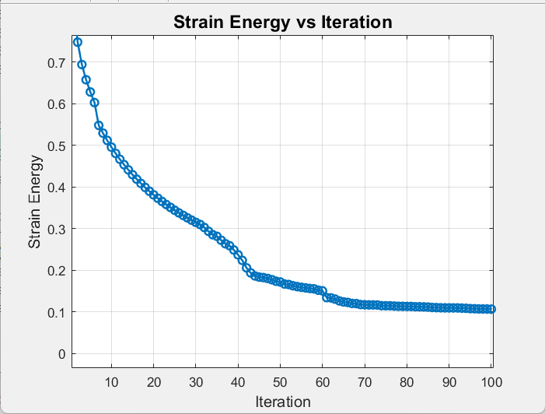
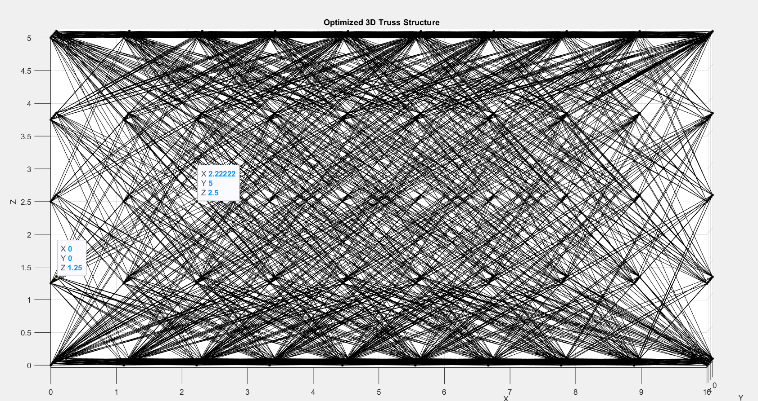
Example(3)

Slide 11
Conclusion
Successfully optimized 3D truss structures for maximum stiffness with a fixed material volume.
Applied the optimality criteria method to efficiently distribute material across truss elements.

Slide 12
Thank you

